Slide 1


Azure DevOps – Intro to Git and Ci/CD best practices
Abhilekha Bhardwaj & Mayank Yadav, May 2020, P&C Center Cluster
1

Slide 2


Table of Contents
Introduction to source control
09
Basic Git Operation
14
Git Commit and Stash
03
The Main Branches
04
Up merge and Down merge
07
Best Practice
12

Slide 3
Introduction to source control
Source Control system
Distributed
local repo
remote repo
Centralized
Make changes to files and keep the history.
Ability to rollback changes
Git is distributed control system.
Branching enables you to work on the code isolated from the others.
When you branch out you intend to merge.
Branches have traceable history to their parents.

Slide 4

Basic Git Operation
Clone
Commit
Push
Pull
Fetch
Stage
Stash

Slide 5
Basic Operations in Detail
Clone
Stage
Pull
Push
Fetch
Used to create a copy of the target branch
Target repo can be local or remote.
git clone <url>
Moves selected changes to partial commit state
Commit
Stage
Revert
To fetch latest changes from remote / local
git pull
git pull origin master
git commit – commits changes to local repo.
git push sends changes to remote repo
git push
fetches latest commits from the origin.
git fetch

Slide 6
Best Practice
Always review the changes you are going to push to remote and
stage them.
Instead of doing git commit all , do git stage commit.
Abhilekha Bhardwaj & Mayank Yadav | May 2020 | P&C Center Cluster
6

Slide 7
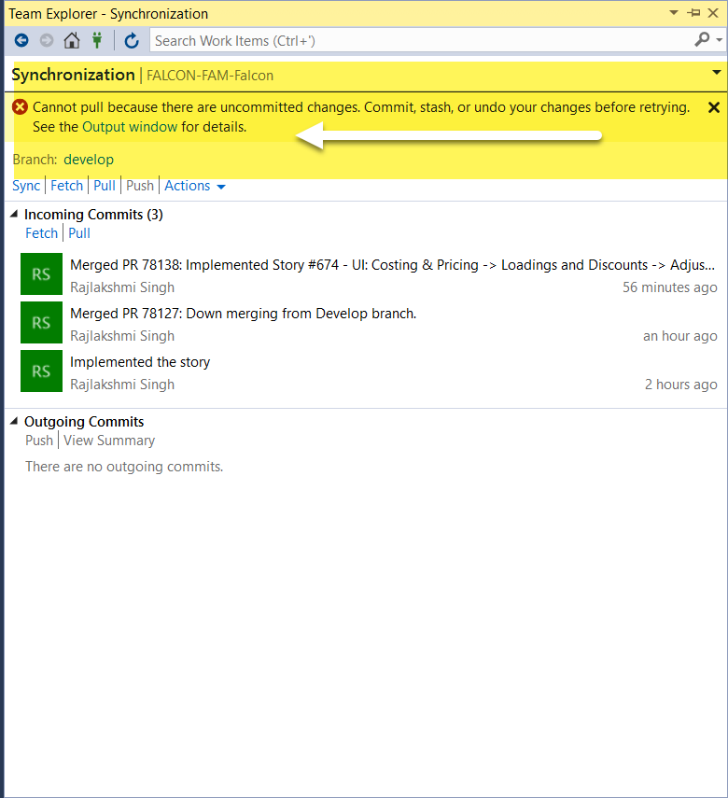
Git Commit and Stash
Git commit is used to commit new changes to local repo.
git push is required to send these changes to remote repo.
But sometimes we face issues while pull and push because changes done on the same branch.
If you don’t want to commit your changes and still need to synchronize the branch , git provides a stack where you can move uncommitted changes.
It’s like undo or revert but changes can be retrieved back without much efforts.

Slide 8
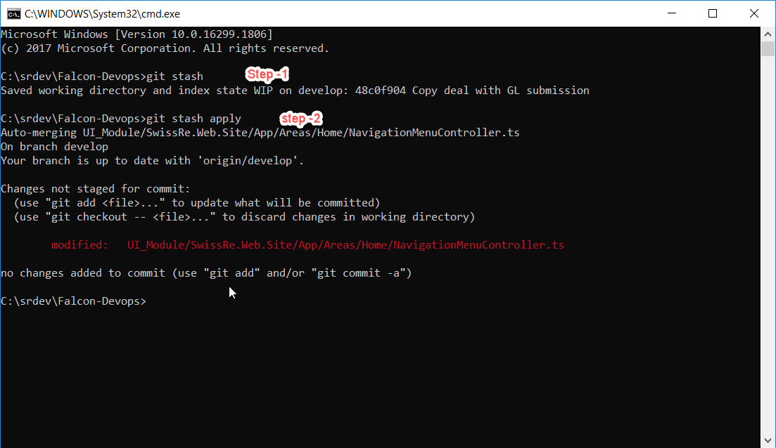
Git Stash

Slide 9

The Main Branches
Master
Always release from master
Master is stable and always ready to release
intermediate branch created to stabilize for release
Develop
Work is done on this branch
Release
Abhilekha Bhardwaj & Mayank Yadav | May 2020 | P&C Center Cluster
9

Slide 10

When moving to continuous delivery try to keep branching at minimum
https://app.pluralsight.com/library/courses/azure-devops-continuous-delivery-source-control
Abhilekha Bhardwaj & Mayank Yadav | May 2020 | P&C Center Cluster
10

Slide 11
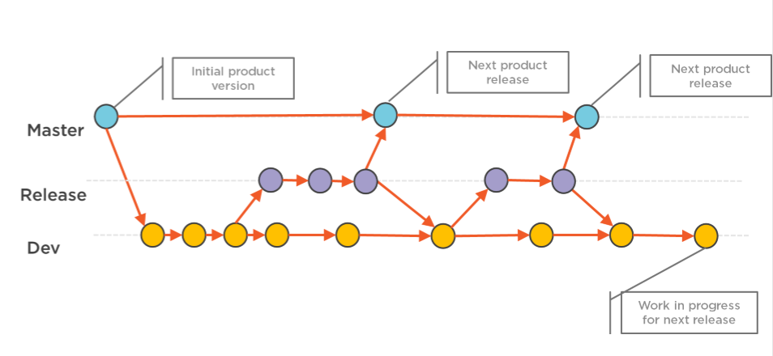
Abhilekha Bhardwaj & Mayank Yadav | May 2020 | P&C Center Cluster
11

Slide 12

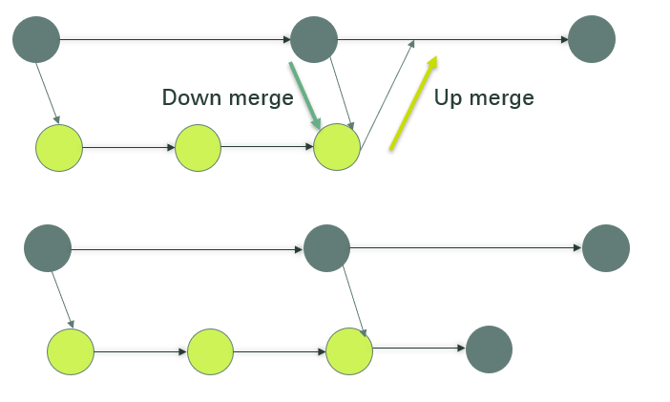

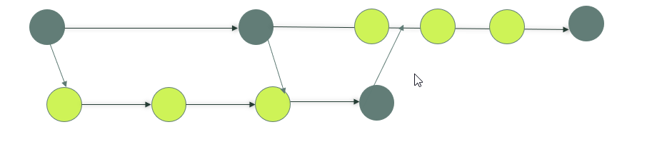
Up merge and Down merge
master
develop
Step -1 Always down merge from the source branch
master
develop
Step -2 Up merge new changes to source branch
master
develop

Slide 13
To Conclude
master
hotfix-branch 1
hotfix-branch-2
develop
feature-develop-1
feature-develop-2
pull-request
must
2 reviewers
Release
branch
tag for master as backup
master+hotfix
Production
pull-request
optional
not required
Demo
no tag required
develop+feature
Merge to master
develop + master
Train

Slide 14
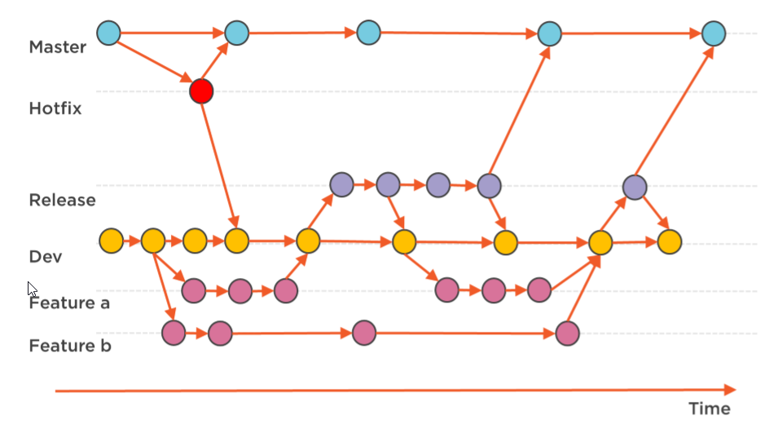
Best Practice
Team member work on branch feature branch.
Feature always merge to dev.
Feature branch is deleted afterwards.
Hotfix is created for production issues.
We merge hotfix to both master and dev.

Slide 15

Any questions?
Abhilekha Bhardwaj & Mayank Yadav | May 2020 | P&C Center Cluster
15

Slide 17
Legal notice
©2019 Swiss Re. All rights reserved. You may use this presentation for private or internal purposes but note that any copyright or other proprietary notices must not be removed. You are not permitted to create any modifications or derivative works of this presentation, or to use it for commercial or other public purposes, without the prior written permission of Swiss Re.
The information and opinions contained in the presentation are provided as at the date of the presentation and may change. Although the information used was taken from reliable sources, Swiss Re does not accept any responsibility for its accuracy or comprehensiveness or its updating. All liability for the accuracy and completeness of the information or for any damage or loss resulting from its use is expressly excluded.

